Slide 1
Seminar II Financial Data Analysis Using Expert Bayesian Framework For Bankruptcy Prediction
Amir Mukeri
M.E. (Computer Engineering) 2021 Candidate.
Roll No. 18MC001
AISSMS College of Engineering, Pune 411001.
mukeriamir@gmail.com

Slide 2
Motivation
Assessing the financial health of any organization is of interest to various stakeholders from investors to regulators.
With ongoing pandemic and uncertainty in economic outlook has brought the issue of predicting the bankruptcy to forefront.
It widely studies and researched topic in academia as well as in industry of tremendous practical relevance.

Slide 3
Introduction
Bankruptcy is a state wherein a corporation is unable to meet or repay its statutory obligations from its operating activities.
Financial ratio analysis helps in identifying such types of bankrupt corporations or corporations headed for bankruptcy in the near future.
Broad set of financial ratios would include liquidity ratios, solvency ratios, profitability ratios, efficiency ratios, coverage ratios, and earnings ratios
Various statistical and machine learning methods are used for this analysis.

Slide 4
Related Work
Altman’s Z-score (E. I. Altman 1968) is a popular method to determine whether a company would go bankrupt or not based on the selected financial ratios.
Logistic regression was used by Ohlson (Ohlson 1980)
Qi Yu et al. (Yu et al. 2014) used Extreme Learning Machines for the prediction which relies on single layer Artificial Neural Network which is evolved with the knowledge of financial ratios to discover the most optimum neural network structure.
Arindam Chaudhary et al. (Chaudhuri and Ghosh 2017) proposed the soft computing approach using fuzzy rough sets.
Lahmiri, S et al. (Lahmiri and Bekiros 2019) proposed the Generalized Regression Topology as an efficient method to arrive at optimized neural architecture search.
Barboza et al. (Barboza, Kimura, and E. Altman 2017) provides detailed survey on the statistical techniques such as Linear Discriminant Analysis (LDA) as well as machine learning techniques such as Support Vector Machine
Notes:
Altman Z-Score = 1.2A + 1.4B + 3.3C + 0.6D + 1.0E Where:
A = working capital / total assets
B = retained earnings / total assets
C = earnings before interest and tax / total assets
D = market value of equity / total liabilities
E = sales / total assets

Slide 5
Gap Analysis
Most of the current method relies on either black box method such Artificial Neural Network where they cannot explain the rationale behind the prediction.
On the other hand, methods such as LDA, Logistic Regression do not provide any uncertainty in the prediction.
Decision makers are not only interested in accuracy of the model but also what is the uncertainty prediction.
For example, an ambulance route taking estimated 10 minutes with uncertainty of 30% and another route estimated to take about 12 minutes with uncertainty of 10%, have different implications.
Secondly, none of this method provide inclusion of domain knowledge from expert right out of the box.
Also, many of these models need the tuning of the hyperparameters, for example, number of neurons or layers and learning rate which is a time consuming and considered as black art (Snoek, Larochelle, and Adams 2012).

Slide 6
Issues and Challenges
Incorporation of uncertainty is done through probability density function using Bayes Theorem:
Computing exact posterior density is a challenge.
Therefore, to overcome this challenge an approximate posterior density is computed using Markov Chain Monte Carlo(MCMC) sampling method.
Availability of data is a challenge. We used Polish companies data from year 2000 to 2012.

Slide 7

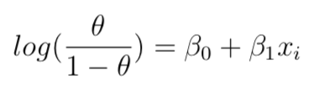
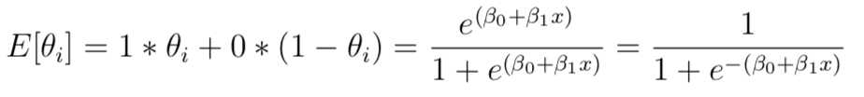
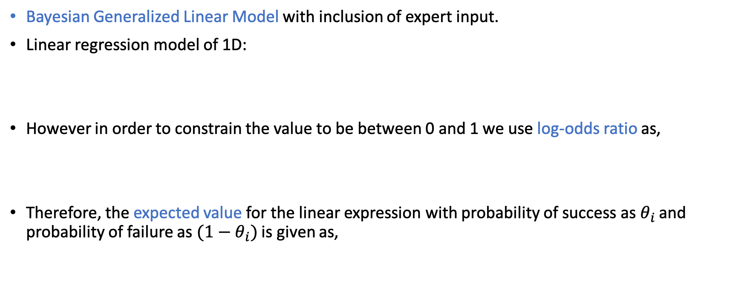
Proposed Work
Bayesian Generalized Linear Model with inclusion of expert input.
Linear regression model of 1D:
However in order to constrain the value to be between 0 and 1 we use log-odds ratio as,
Therefore, the expected value for the linear expression with probability of success as $θ_{i}$ and probability of failure as $(1−θ_{i})$ is given as,

Slide 8


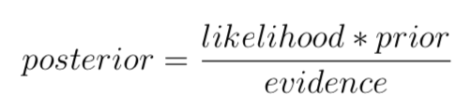
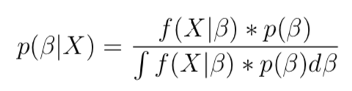
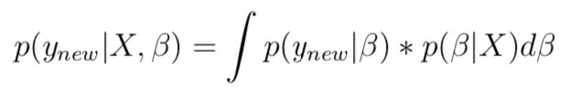
Bayesian GLM
In order to build Bayesian linear regression model, we can select priors on intercept and coefficient, for example, to be normally distributed as,
In order to compute the posterior distribution of parameter vector using Bayesian inference,
The posterior predictive distribution for a new example is given by

Slide 9
Methodology
Data Pre-processing & Scaling
Exploratory Analysis
Variable/Feature selection
Model building, Evaluation and Selection
Hypothesis testing and uncertainty quantification
Presentation
Repeat above process until termination criteria
Stan, probabilistic programming language was used for modelling using rstanarm in R

Slide 10
Modeling
Model#2 Ratios
book value of equity / total liabilities
equity / total assets
gross profit / short-term liabilities
(inventory * 365) / sales
operating expenses / short-term liabilities
(current assets - inventory - receivables) / short-term liabilities
profit on operating activities / sales
(current assets - inventory) / short-term liabilities
EBITDA (profit on operating activities - depreciation) / sales
long-term liabilities / equity
sales / short-term liabilities
sales / fixed assets
Model#1 Ratios
[(cash + short-term securities + receivables - short-term liabilities) / (operating expenses - depreciation)] * 365
gross profit (in 3 years) / total assets
(equity - share capital) / total assets
(net profit + depreciation) / total liabilities
operating expenses / total liabilities
 | ELPD Diff | Std Err
Model#2 | 0.0 | 0.0
Model#1 | -0.1 | 13.6

Slide 11
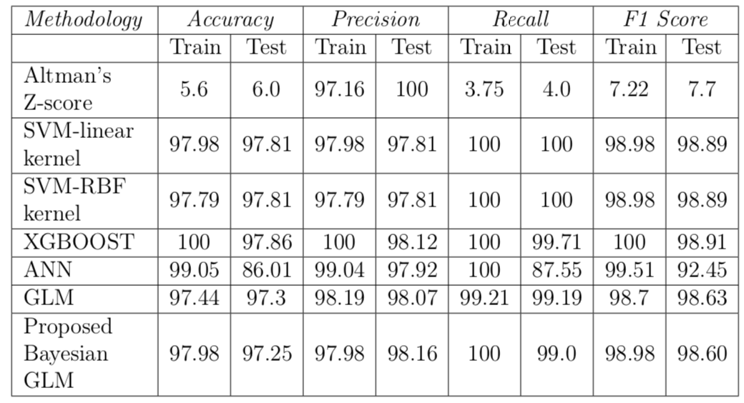
Results and Discussion

Slide 12
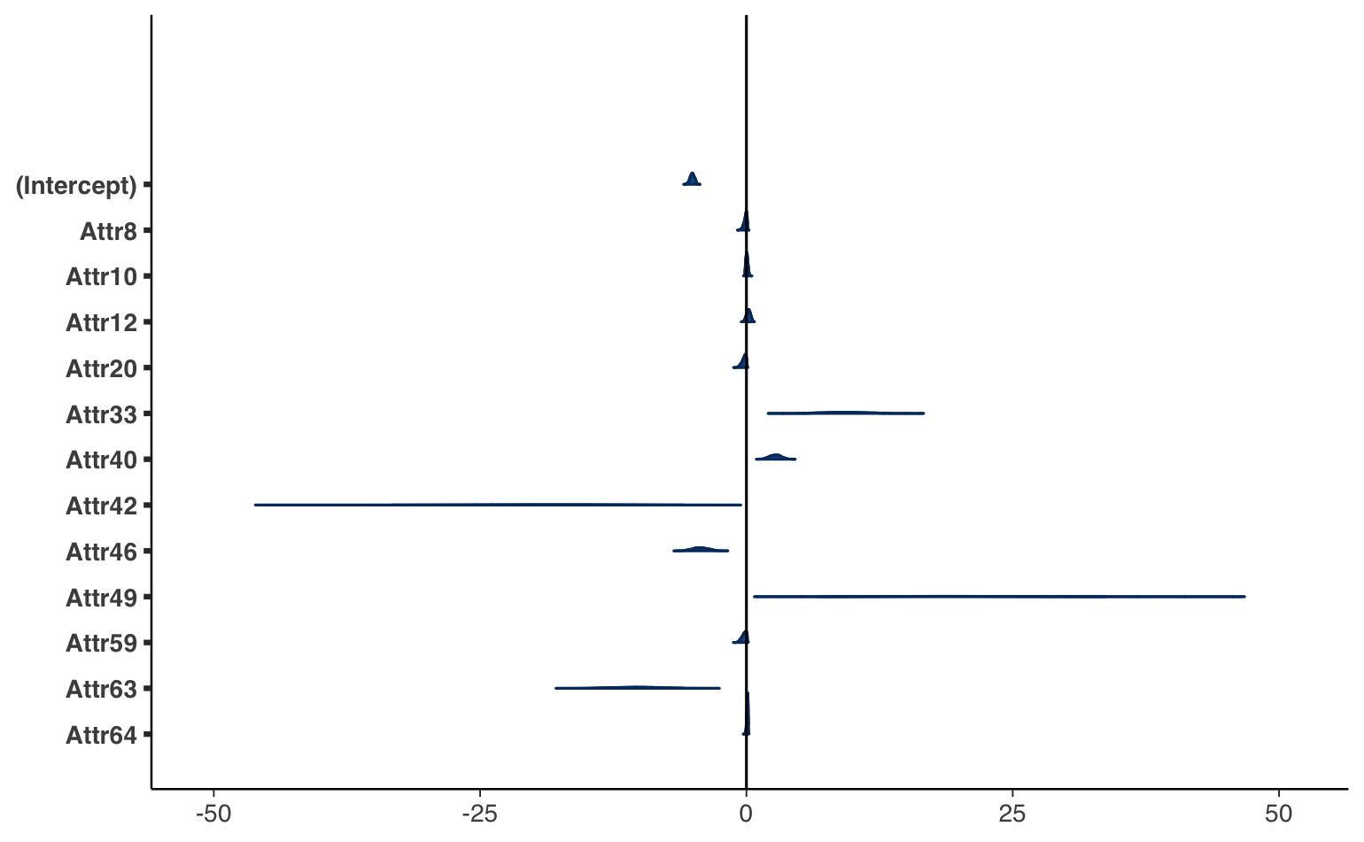
Insight
To determine if an attribute is significant or not we used ROPE (Region of Practical Equivalence) . ROPE value provides the percentage of Credible Interval(CI) that is in the null region. With sufficiently high value of ROPE the null hypothesis is accepted otherwise rejected.
Few Significant Attributes:
Attr33 (operating expenses / short-term liabilities) has a probability of 100% of being positive and can be considered as large and significant (median = 9.22, 89% CI [5.93, 12.31], 0% in ROPE, std. median = 9.22).
Attr42 (profit on operating activities / sales) has a probability of 100% of being negative and can be considered as large and significant (median = -19.73, 89% CI [-31.69, -8.29], 0.03% in ROPE, std. median = -19.73).
Attr63 (sales / short-term liabilities) has a probability of 100% of being negative and can be considered as large and significant (median = -10.33, 89% CI [-14.01, -7.09], 0% in ROPE, std. median = -10.33).

Slide 13
Conclusion
The proposed Bayesian GLM model and methodology meets the critical requirements of interpretability as well as inclusion of expert judgement in all the phases of model building process.
Secondly, the proposed method do not need any hyperparameter tuning or neural architecture search
It was found that specifically looping in expert reduced the time for the model building and model selection considerably compared to other combinatorial and computationally intensive methods
At the end of the analysis we found that the ratios involving short term liabilities were strong predictors of companies going bankrupt.
Entire code is available on Github

Slide 14
Future Work
Bayesian GLM with Expert input could be used for other risk management domains such cybersecurity defence.
Scaling the Bayesian methods to larger dataset remains a challenge and active area of research.

Slide 15
Acknowledgements
Special thanks to Mr. Habibullah Shaikh for his inputs as a finance expert in this research and my seminar topic guide Dr. D.P. Gaikwad for his guidance and support.

Slide 16
References
Altman, Edward (1968). “Financial ratios, discriminant analysis and the prediction of corporate bankruptcy”. In: The journal of finance 23.4, pp. 589–609.
Barboza, Flavio, Herbert Kimura, and Edward Altman (2017). “Machine learning models and bankruptcy prediction”. In: Expert Systems with Applications 83, pp. 405–417.
Brownstein, Naomi C et al. (2019). “The role of expert judgment in statistical infer-ence and evidence-based decision-making”. In: The American Statistician 73.sup1, pp. 56–68.
Carpenter, Bob et al. (2017). “Stan: A probabilistic programming language”. In: Journal of statistical software 76.1.
Chaudhuri, Arindam and Soumya K Ghosh (2017). Bankruptcy prediction through soft computing based deep learning technique. Springer.
Devi, S Sarojini and Y Radhika (2018). “A survey on machine learning and statistical techniques in bankruptcy prediction”. In: International Journal of Machine Learning and Computing 8.2, pp. 133–139.
Gelman, Andrew et al. (2013). Bayesian data analysis. CRC press. Hoffman, Matthew D and Andrew Gelman (2014). “The No-U-Turn sampler: adaptively setting path lengths in Hamiltonian Monte Carlo.” In: J. Mach. Learn. Res.
15.1, pp. 1593–1623. IMF (2020). “World Economic Outlook:A Long and Difficult Ascent”. In: World Economic Outlook (WEO) Washington, DC, October.
Kaggle (2018 (accessed October 29, 2020)). Companies bankruptcy forecast. https: //www.kaggle.com/c/companies-bankruptcy-forecast/data. url: https: //www.kaggle.com/c/companies-bankruptcy-forecast/overview.
Kruschke, John (2014). Doing Bayesian data analysis: A tutorial with R, JAGS, and Stan. Academic Press.
Lahmiri, Salim and Stelios Bekiros (2019). “Can machine learning approaches predict corporate bankruptcy? Evidence from a qualitative experimental design”. In: Quantitative Finance 19.9, pp. 1569–1577.
Makowski, D and D Lüdecke (2019). “The report package for R: Ensuring the use of best practices for results reporting”. In: CRAN.
Muth, Chelsea, Zita Oravecz, and Jonah Gabry (2018). “User-friendly Bayesian regression modeling: A tutorial with rstanarm and shinystan”. In: Quantitative Meth- ods for Psychology 14.2, pp. 99–119.
Ohlson, James A (1980). “Financial ratios and the probabilistic prediction of bankruptcy”. In: Journal of accounting research, pp. 109–131.
Snoek, Jasper, Hugo Larochelle, and Ryan P Adams (2012). “Practical bayesian optimization of machine learning algorithms”. In: Advances in neural information processing systems, pp. 2951–2959.
Vehtari, Aki, Andrew Gelman, and Jonah Gabry (2017). “Practical Bayesian model evaluation using leave-one-out cross-validation and WAIC”. In: Statistics and com- puting 27.5, pp. 1413–1432.
Vehtari, Aki, Andrew Gelman, Daniel Simpson, et al. (2020). “Rank-normalization, folding, and localization: An improved Rhat for assessing convergence of MCMC”. In: Bayesian Analysis.
Yu, Qi et al. (2014). “Bankruptcy prediction using extreme learning machine and financial expertise”. In: Neurocomputing 128, pp. 296–302.
Zięba, Maciej, Sebastian K Tomczak, and Jakub M Tomczak (2016). “Ensemble boosted trees with synthetic features generation in application to bankruptcy pre- diction”. In: Expert systems with applications 58, pp. 93–101.

